Slide 1

ARTIFICIAL INTELLIGENCE
AI

Slide 2

ARTIFICIAL INTELLIGENCE TYPES
NARROW AI
GENERAL AI
SUPER AI

Slide 3

NRROW AI [WEAK AI]
NAEEOW AI IS ALSO CALLED WEAK AI IS A TYPE OF ARTIFICIAL INTELLIGENCE THAT IS DESIGNED TO DO ONE SPECIFIC TASK

Slide 4
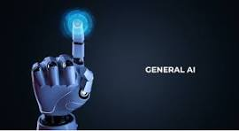
General AI [AGI]
General ai is a type of ai that can think learn and understand anything just like a human

Slide 5
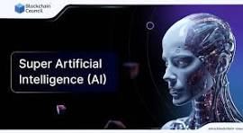
Super ai [ artificial super intelligence ]
Super ai is a theoretical type of ai that would be more intelligent than humans in every way thinking learning decision making creativity and emotions

Slide 6
THE END

